Slide 1
FEATURES OF ANGULAR 7!!
PRADEEP PONUGUMAATI
5067644

Slide 2
CONTENTS
Animations
CLI Prompts
Angular Material & Component dev Kit(CDK)
Drag And Drop

Slide 3
ANIMATIONS
Animation provides the illusion of motion, HTML elements change styling over time.
Well-designed animations can make your application more fun and easier to use, but they aren't just cosmetic.
Without animations, web page transitions can seem abrupt and jarring.
Motion greatly enhances the user experience, so animations give users a chance to detect the application's response to their actions.
Good animations intuitively call the user's attention to where it is needed.

Slide 4
Getting started With Animations
The main Angular modules for animations are @angular/animations and @angular/platform-browser. When you create a new project using the CLI, these dependencies are automatically added to your project.
There are three steps involved in aminations.
Step 1: Enabling the animations module
Step 2: Importing animation functions into component files
Step 3: Adding the animation metadata property

Slide 5
Step 1: Enabling the animations module
src/app/app.module.ts
import { NgModule } from '@angular/core’;
import { BrowserModule } from '@angular/platform-browser’;
import { BrowserAnimationsModule } from '@angular/platform- browser/animations’;
@NgModule({
imports: [
BrowserModule,
BrowserAnimationsModule
],
declarations: [ ],
bootstrap: [ ]
})
export class AppModule { }

Slide 6
Step 2: Importing animation functions into component files
src/app/app.component.ts
import { Component, HostBinding } from '@angular/core’;
import {
trigger,
state,
style,
animate,
transition,
// ...
} from '@angular/animations';

Slide 7
Step 3: Adding the animation metadata property
You put the trigger that defines an animation within the animations metadata property.
src/app/app.component.ts
@Component({
selector: 'app-root’,
templateUrl: 'app.component.html’,
styleUrls: ['app.component.css’],
animations: [
// animation triggers go here
]
})

Slide 8
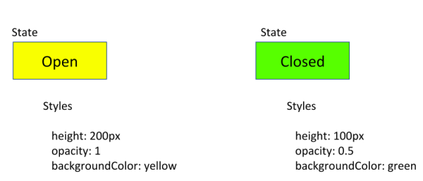
Animating a simple transition
Let's animate a simple transition that changes a single HTML element from one state to another.
For example, you can specify that a button displays either Open or Closed based on the user's last action.

Slide 9
Animation state and styles
Use Angular's state() function to define different states to call at the end of each transition.
This function takes two arguments: a unique name like open or closed and a style() function.
Use the style() function to define a set of styles to associate with a given state name. Note that the style attributes must be in camelCase.
Let's see how Angular's state() function works with the style⁣­(⁠) function to set CSS style attributes.
In the open state, the button has a height of 200 pixels, an opacity of 1, and a background color of yellow.
state('open', style({
height: '200px’,
opacity: 1,
backgroundColor: 'yellow’
})),

Slide 10
Continued..
In the closed state, shown below, the button has a height of 100 pixels, an opacity of 0.5, and a background color of green.
state('closed', style({
height: '100px’,
opacity: 0.5,
backgroundColor: 'green’
})),

Slide 11
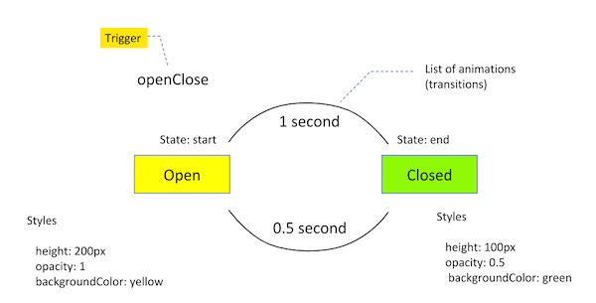
Triggering the animation
An animation requires a trigger, so that it knows when to start. The trigger() function collects the states and transitions, and gives the animation a name, so that you can attach it to the triggering element in the HTML template.
The trigger() function describes the property name to watch for changes. When a change occurs, the trigger initiates the actions included in its definition. These actions can be transitions or other functions, as we'll see later on.

Slide 12
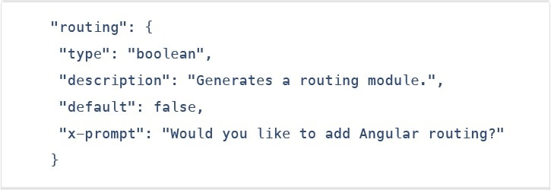
CLI Prompts
In Angular 7, the CLI prompts have been updated to v7.0.2 with new features. For instance, it will now prompt users when typing commands like @angular/material, ng-new, and ng-add to help them discover the in-built SCSS support, routing, and more.
These CLI prompts, in addition, have been added to Schematics, so that all package publishing schematics can now benefit from CLI prompts.

Slide 13
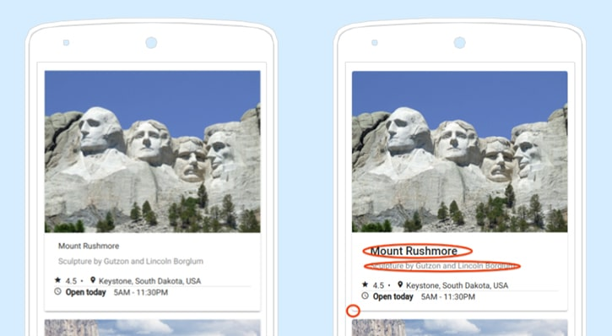
Angular material & component dev kit (CDK)
The Angular 7 introduced minor visual updates & improvements in Material Design that earlier received a major update this year only.
In addition, refresh, virtual scrolling, large lists of data, dynamic loading and unloading of parts of the DOM also were the part of improvements in CDK and Angular Material.

Slide 14
Continued..
Furthermore, the applications in Angular 7 can now also be fitted with drag-and-drop functionality by either importing ScrollingModule or DragDropModule.

Slide 15
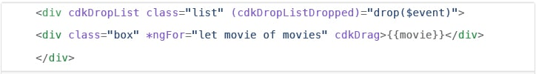
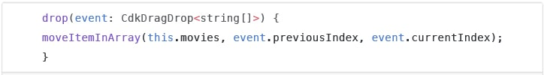
Drag & drop
The new drag-drop module basically provides a better way to easily create drag & drop interfaces, which is backed by sorting within a list, support for free dragging, animations, custom drag handles, transferring items between lists, previews, and placeholders.
In simple terms, the Drag-and-Drop support has now been implemented in CDK and it also includes automatic rendering as the users relocates items.

Slide 16
THANK YOU

